Slide 1

Minor Project Final Viva –Voce Master of Computer Applications III Semester – 2023
School of Computer Science and Applications

Slide 2
A PROJECT REPORT ON Rainfall Prediction Using Deep Learning
Submitted Final Viva-Voce Project report completion of MCA degree
Presented by:
Mr. Akshay G
SRN: R21DE109
Mr. Amit R Nagari
SRN: R21DE110
Internal Guide: Prof. Abhay Kumar Srivastav

Slide 3
Agenda
Existing System
Proposed System
Advantages of Proposed System
Methodology Used
Architecture Diagram
Class Diagram
Testing Strategy
Implementation
Result
Future Enhancement

Slide 4
Existing System
The existing system for rainfall prediction using deep learning is a combination of various deep learning models such as Convolutional Neural Networks (CNNs), Long Short-Term Memory (LSTM) networks and Attention-based LSTMs. These models are used to predict rainfall patterns based on historical rainfall data and meteorological parameters such as temperature, pressure, and humidity.
The existing system utilizes a supervised learning approach where the models are trained using historical rainfall data and meteorological parameters. The model's performance is evaluated using various metrics such as root mean square error (RMSE) and mean absolute error (MAE).
The existing system's main advantage is its ability to capture complex temporal and spatial patterns in rainfall data, leading to more accurate rainfall predictions

Slide 5
Proposed System
A proposed system for rainfall prediction using deep learning can address some of the limitations of the existing system. Here are some of the potential strategies that can be implemented in a proposed system:
Use of alternative data sources
Integration of multiple models
Transfer learning
Explainable AI
Ethical considerations
Integration with existing systems

Slide 6
Advantages of Proposed System
The proposed system for rainfall prediction using deep learning has several advantages over the existing system. Here are some of the potential advantages of the proposed system:
Improved accuracy
Generalizability
Interpretability
Scalability
Integration with existing systems
Ethical considerations

Slide 7
Methodology Used
Load the rainfall dataset from a CSV file using Pandas library and extract only the Date and Rainfall columns.
Convert the Date column to datetime and set it as the index for the data.
Fill any missing values in the data with 0.
Split the data into training and testing sets based on a specified date range.
Normalize the data using MinMaxScaler from the scikit-learn library to scale the values between 0 and 1.
Create sequences of input-output pairs for the model by using a sliding window approach. The lookback parameter determines the length of the input sequence, and the output is the next value in the time series.

Slide 8
Define the CNN model architecture using the Sequential model from the Keras library.
Train the model using the training data and validate it using the testing data. The model is compiled using Adam optimizer and Mean Squared Error (MSE) loss function.
Use EarlyStopping from Keras to stop training the model if the validation loss does not improve for a specified number of epochs.
Make predictions on the training and testing data using the trained model and calculate the Root Mean Squared Error (RMSE) between the predicted and actual values.
Plot the training and testing loss curves to visualize the model's performance during training.

Slide 9
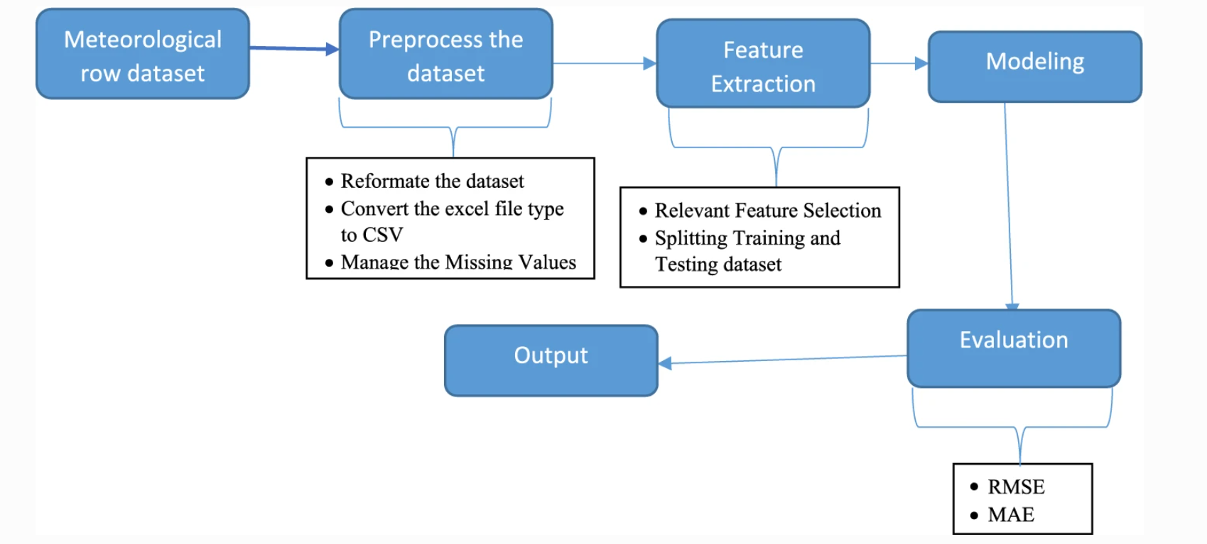
Architecture Diagram

Slide 10
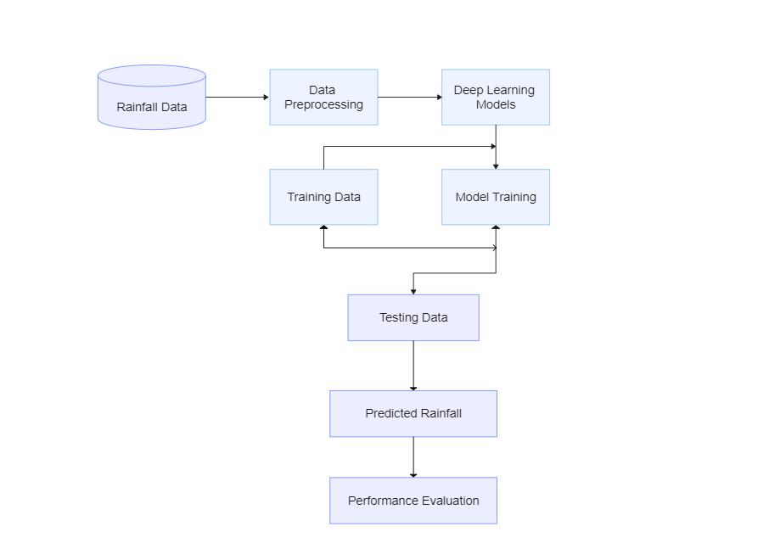
Class Diagram

Slide 11
Testing Strategy
Verify that the data is loaded and preprocessed correctly by checking the shape of the training and testing data. Try changing the hyperparameters of the model, such as the number of filters in the convolutional layer or the learning rate of the optimizer, to see how they affect the RMSE.
Consider using other evaluation metrics, such as mean absolute error (MAE), to compare the performance of different models.
Testing and Evaluation: The trained model is used to predict the output values for the training and test input sequences. The root mean squared error (RMSE) is calculated for both the training and test predictions using the mean_squared_error function from sklearn. The RMSE values are printed to the console. Additionally, the training and test losses are plotted using the training history stored in 'history'. This should be described in the report, along with any reasoning behind the choice of evaluation metrics used.

Slide 12
Implementation
Implementing a rainfall prediction system using deep learning involves several steps:
Data collection
Data pre-processing
Model development
Model training
Model evaluation
Prediction
Visualization
Deployment

Slide 13
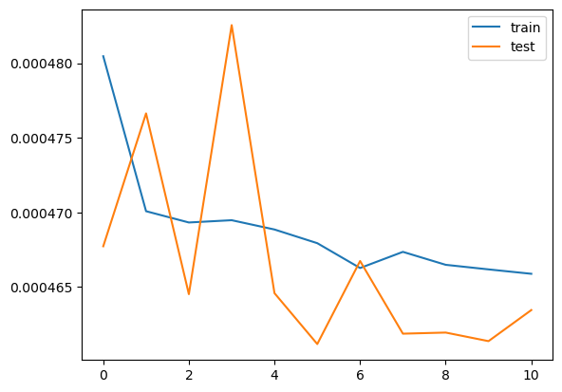
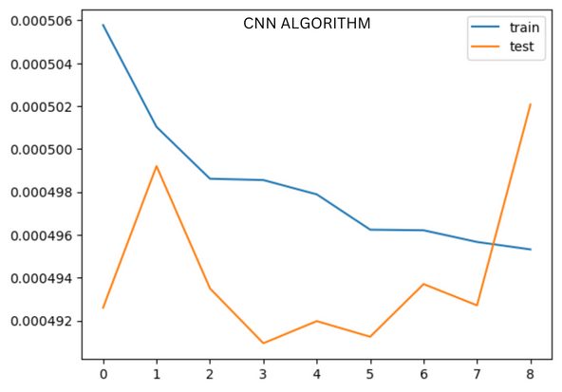
Result
Use the trained model to predict the rainfall for the test set.
Calculate the root mean squared error (RMSE) between the predicted and actual values for both the training and test sets.

Slide 14
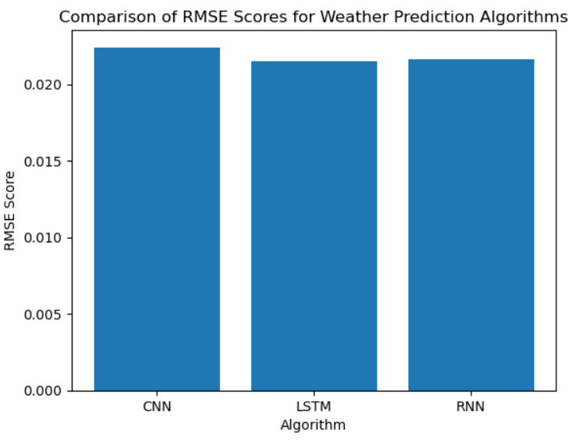
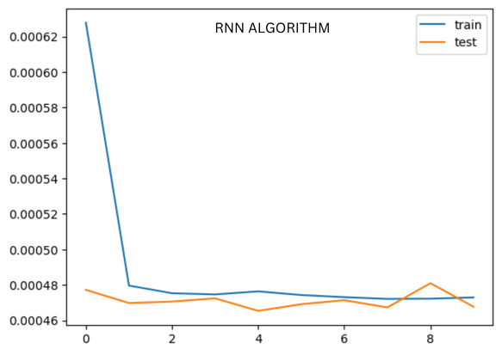

Slide 15
Future Enhancement
Integration of additional data sources: Currently, most rainfall prediction systems rely on weather station data. However, there are many other data sources that could be integrated, such as satellite imagery, social media posts, and crowd-sourced data.
Incorporation of climate change models: Climate change is likely to have a significant impact on rainfall patterns in many regions. Incorporating climate change models into the rainfall prediction system could help forecast changes in rainfall patterns over the long term.

Slide 16
Real-time prediction and visualization: Currently, most rainfall prediction systems provide predictions on a daily or hourly basis. However, users often need more frequent and timely predictions. Developing real-time prediction and visualization capabilities could enable users to respond more quickly to changing weather conditions.
Multi-task learning: Multi-task learning involves training a deep learning model to perform multiple related tasks simultaneously. For example, a rainfall prediction model could be trained to predict both rainfall amount and duration. Multi-task learning could improve the efficiency and accuracy of the model

Slide 17
Thank You

Slide 18







Icons
Architecture
Commerce
Legal Studies
Arts & Humanities
Performing Arts
Management Studies
Science & Tech
Engineering

